Slide 1
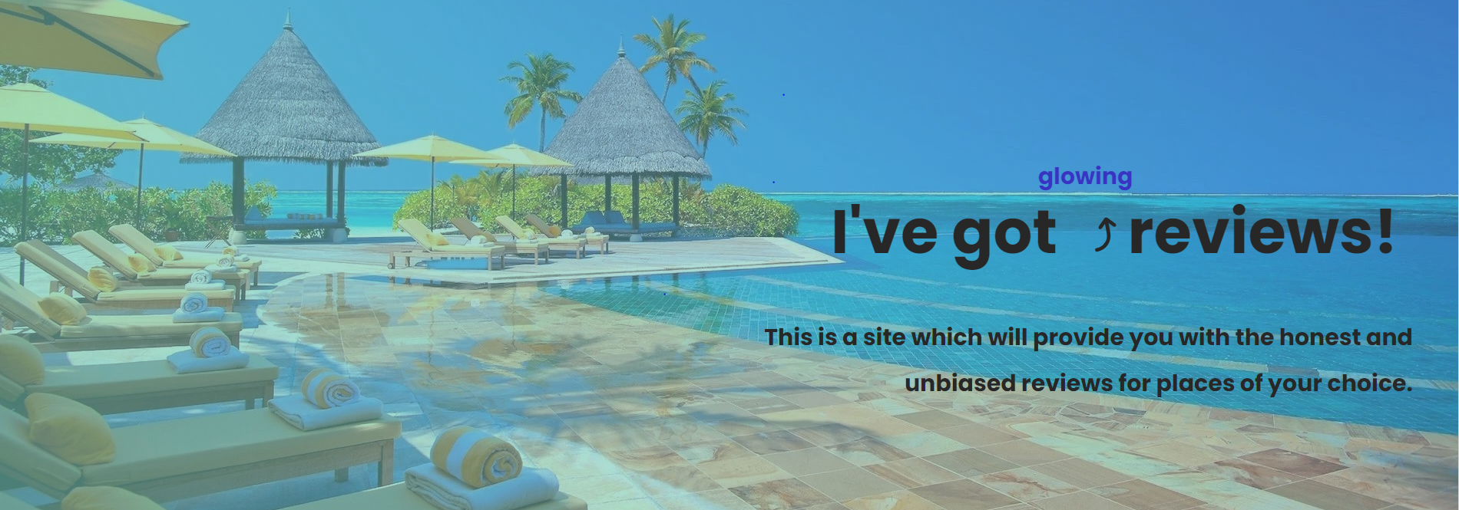
REVIEW US

Slide 2
ABOUT
Through this page, we are presenting a platform for users to provide us with their reviews and store the reviews provided by them.
We have created this page with our combined knowledge of different technologies like NodeJS, CSS, HTML, and the database MongoDB.

Slide 3
Home page
We welcome you with a very calming image to our review page. A nice animation tells you about the glowing reviews that you may provide us for the different organizations.
We provide you with hyperlinks of our review pages on our homepage.
To solve any queries or grievances, we have provided a page for users to contact for the same.
For our personal growth and improvement, we have provided a page for users to provide us with their suggestions.

Slide 4
RESORT
Different destinations need different accommodations and for best accommodation your one stop destination is our site,where you can find honest and unbiased reviews as well.
In a form format we have provided some criterias along which users can provide us with their reviews and they are:
Resort name
Rating for the resort and
Written review

Slide 5
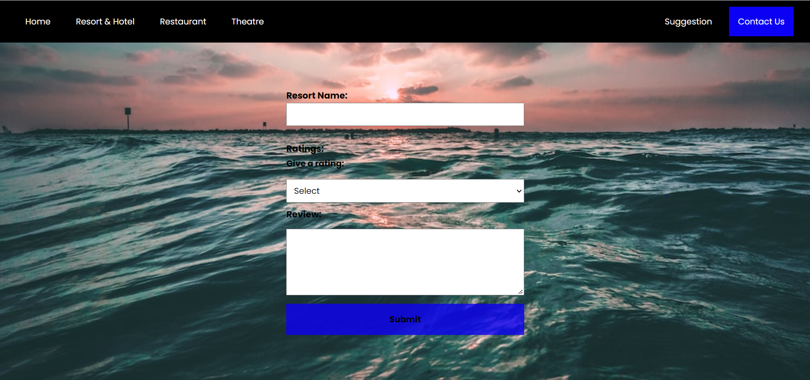

Slide 6
RESTAURANT
Good food fills your stomach and makes you happy and the place that will suggest you to find good food and honest and unbiased reviews is us.
In a form format we have provided some criterias along which users can provide us with their reviews and they are:
Restaurant name
Rating for the restaurant and
Written review

Slide 7
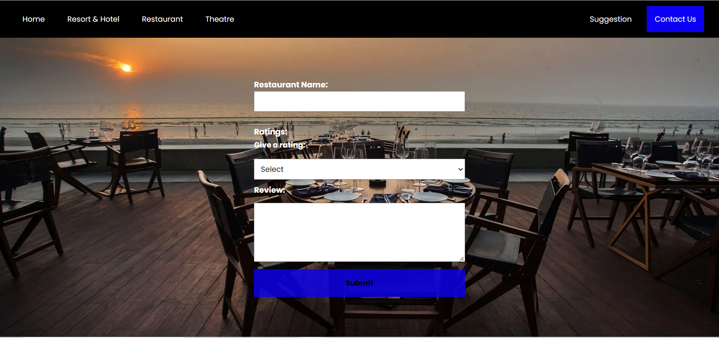

Slide 8
THEATRE
A nice movie theater and some popcorn can make a movie more interesting We have got honest reviews to make sure your experience is great.
In a form format we have provided some criteria along which users can provide us with their reviews and they are:
Theatre name
Rating for the theatre and
Written review

Slide 9
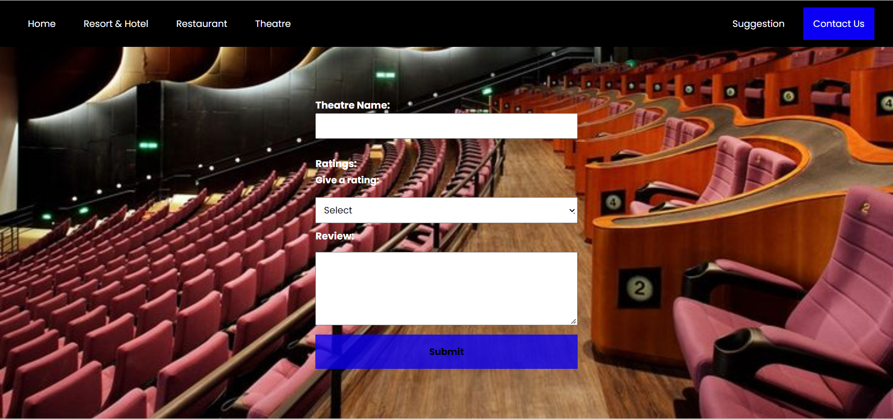

Slide 10
CONTACT US
To solve any queries or grievances, we have provided a page for users to contact for the same.
We have provided tabs through which users can directly call or mail us their issues or problems and some companion phone numbers and email Ids to reach us in times of need.

Slide 11
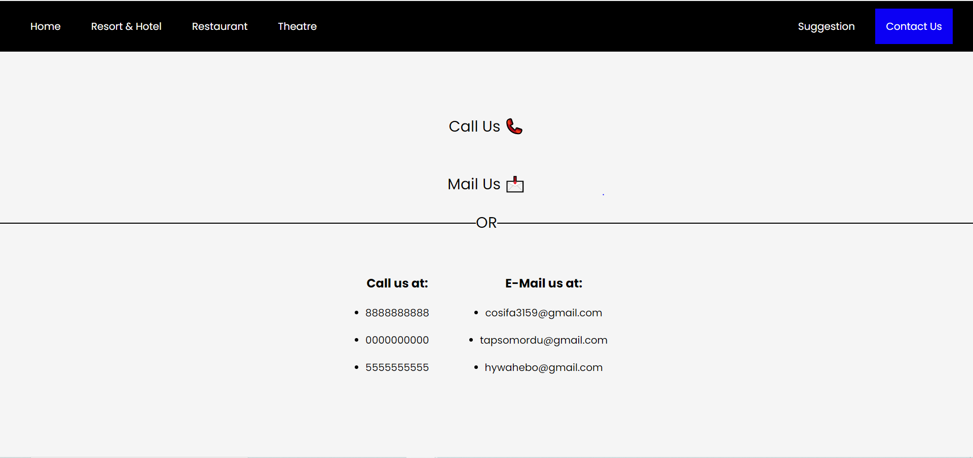

Slide 12
SUGGESTION
For our personal growth and improvement, we have provided a page for users to provide us with their suggestions.
In a form format we have provided some criterias along which users can provide us with their reviews and they are:
Name of the review provider
Age
Written review

Slide 13
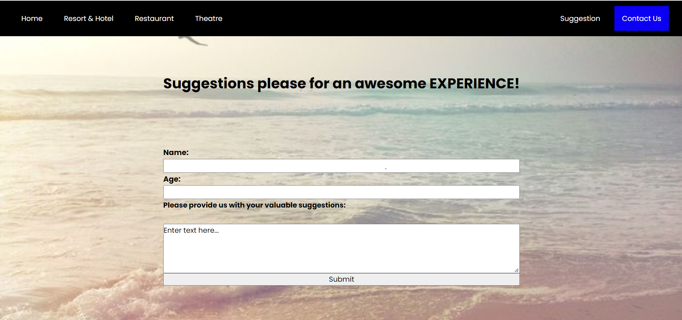

Slide 14
DATABASE
We have used MongoDB as a database to store the review data i.e. entered by the users.
We have created a single database and a single table which stores all of our data and uses unique IDs to distinguish between different records.

Slide 15
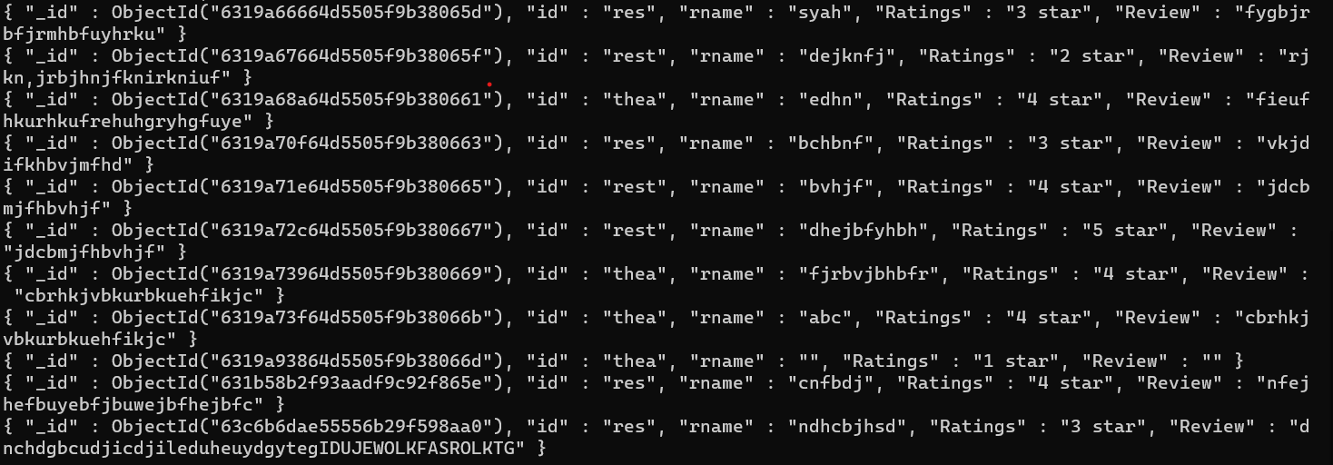

Slide 16

Thank You
Made By:
Abhay Gupta
Kirti Parashar
Sagar Maheshwari
Yug Gupta

